Slide 1
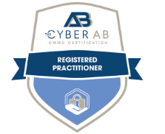
Upcoming CMMC 2.0 Requirements for Health Care Contractors
Michael G. Gruden (CMMC-RP)
Payal Nanavati
July 31, 2024

Slide 2
Agenda
Who is in Scope for CMMC Requirements?
Types of Regulated Data
Exceptions
CMMC Overview
How We Got Here: Cybersecurity Retrospective
Overview of CMMC Proposed Rule
CMMC Documentation: NIST SP 800-171 SSPs & POA&Ms
Assessments & Certification
Supply Chain Considerations
Health Care & Cybersecurity Enforcement Risks
Top 5 CMMC Certification Takeaways

Slide 3
Who is in Scope?
The Cybersecurity Maturity Model Certification (CMMC) standard applies to all entities within the DoD supply chain, including organizations that handle federal contract information (FCI), controlled unclassified information (CUI), and other sensitive information regardless of the specific organization with which the contract is placed.
Generally, companies with contracts that contain the FARS/DFARS clauses who also have regulated data
Customers
DLA
DoD
DHA
Programs
TRICARE
Military Health System
DLA Troop Support

Slide 4
Types of Regulated Data
Federal Contract Information (FCI)
Any information handled specifically under a government contract
Except public or simple transactional information
Controlled Unclassified Information (CUI)
Any federal information that requires protection under law, regulation, or Government-wide policy
Identified in the CUI Registry
Must have a Government nexus
Covered Defense Information (CDI)
Any CUI handled by DoD contractors
Must be identified as such by customer

Slide 5
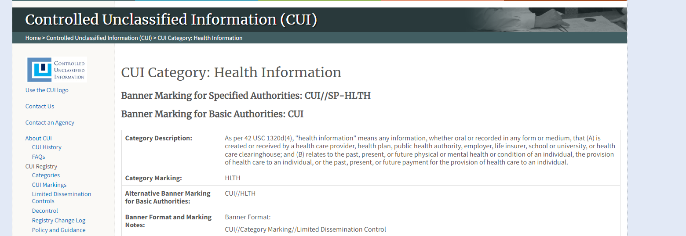
Controlled Unclassified Information (CUI)
Specifically includes Health Information CUI Category
https://www.archives.gov/cui/registry/category-list
Crowell & Moring LLP | 4

Slide 6
CMMC Exceptions
“(c) CMMC Program requirements apply to all DoD solicitations and contracts pursuant to which a defense contractor or subcontractor will process, store, or transmit FCI or CUI on unclassified contractor information systems, including those for the acquisition of commercial items (except those exclusively for COTS items) valued at greater than the micropurchase threshold.”
32 CFR § 170.3

Slide 7
Commercially Off the Shelf (COTS) Determination
Commercially available off-the-shelf (COTS) item —
A product, other than real property, that is of a type customarily used by the general public or by nongovernmental entities for purposes other than governmental purposes, and has been offered, sold, leased, or licensed to the general public
Sold in substantial quantities in the commercial marketplace
Offered to the Government, under a contract or subcontract at any tier, without modification, in the same form in which it is sold in the commercial marketplace

Slide 8
How We Got Here

Slide 9
NIST Cybersecurity Standards
NIST = National Institute of Standards & Technology // SP = Special Publication
NIST SP 800-171 Rev. 2
Security standard for contractor systems handling CUI.
Includes 110 controls across 14 categories (or “families”).
Implemented via administrative, technical, and/or physical means.
NIST SP 800-172
Supplement to NIST SP 800-171, featuring enhanced security requirements for contractor systems handling CUI associated with critical programs or high value assets.
NIST SP 800-171A/172A
Companion assessment guides.
NIST SP 800-53, Rev. 5
Security standard for federal information systems and FedRAMP Moderate baseline

Slide 10
Cybersecurity Retrospective
2013 – 2016
Safeguarding CUI
DFARS 7012
Jan 2020
CMMC Introduced
Sept 2020
NIST Basic Assessment
DFARS 7019, 7020
Oct 2021
DOJ Civil Cyber Fraud Initiative
Late 2024
CMMC Active
DFARS 7021
Requires contractors to document compliance with NIST SP 800-171 or FedRAMP Moderate for cloud-based solutions.
Contractors must report incidents affecting CUI
Must be flowed down to subcontractors
Comprehensive CUI protection
Certification required before contract award
Compliance evaluated by third-party assessors
7019/20: requires self-assessment and scoring compliance with NIST SP 800-171.
Enables government cyber audits
7021: CMMC certification requirement (inactive)
Must be flowed down to subcontractors
DOJ announces that it will use False Claims Act (FCA) to enforce cyber noncompliance.
DoD expects CMMC requirements finalized in late 2024.

Slide 11
FAR Safeguarding Clause
FAR 52.204-21 (JUN 2016), Basic Safeguarding of Covered Contractor Information Systems
Mandatory in (almost) all contracts with mandatory flowdown
Requires protection of FCI residing on contractor information systems via 17 controls pulled from NIST SP 800-171
Controls reflect “basic” cyber hygiene
Controls must be full implemented before handling FCI

Slide 12
DFARS Safeguarding Clause
DFARS 252.204-7012 (DEC 2019), Safeguarding Covered Defense Information and Cyber Incident Reporting
Incorporated into all DoD contracts to protect CDI
Also required to ensure delivery of “operationally critical support”
Located in Section I, Contract Clauses and/or referenced in Section C, Statement of Work/Performance Work Statement
Automatic self-certification when bidding on contracts with the Clause
Three primary requirements:
Protect CDI residing on contractor’s networks;
Rapidly report cyber incidents affecting CDI; and
Flowdown these obligations to subcontractors handling CDI

Slide 13
DFARS Safeguarding Clause
Adequate Security
If a contractor processes, stores, or transmits CDI on its information system it must implement “adequate security” on those systems to protect CDI
DoD defines the system’s scope based on logical segregation (or lack thereof)
Contractor achieves adequate security by:
Implementing at least NIST SP 800-171, and/or
Using external cloud services that meet the FedRAMP Moderate baseline requirements
Security documented in “system security plans” and “plans of action & milestones”

Slide 14
DFARS Safeguarding Clause
Rapid Reporting
Contractors must report “cyber incidents” that “affect” CDI or the system on which it resides
Designed to enable intelligence gathering
Cyber incidents broadly defined to include unauthorized disclosure, modification, destruction, loss, or copying
DoD does not define what it means to “affect” CDI or the overall system
Contractor must report through a DIBNet portal within 72 hours of discovery
Contractor must preserve and protect images of all systems and relevant monitoring/packet capture data for at least 90 days

Slide 15
DFARS Safeguarding Clause
Flowdowns
Contractor must flow down the clause without alteration to subcontractors whose performance requires CDI (or the provision of operationally critical support)
Contractors must also require subcontractors to:
Notify contractor when submitting requests to DoD CIO to vary from NIST SP 800-171
Provide contractor with incident report number issued by DoD after submitting a cyber incident report

Slide 16
NIST SP 800-171 DoD Assessments
DFARS 252.204-7019 (NOV 2020), Notice of NIST SP 800-171 DoD Assessment Requirements
DFARS 252.204-7020 (NOV 2020), NIST SP 800-171 DoD Assessment Requirements
Standardized mechanism to assess how thoroughly a contractor has implemented NIST SP 800-171, per DFARS 252.204-7012
Assessments come in three forms:
Basic Assessment: Contractor self-assessment, required for new contracting actions after November 30, 2020
Medium/High Assessments: Government assessments, performed at customer’s discretion after award
Assessment scores are uploaded to the DoD’s Supplier Performance Risk System (SPRS) and generally remain current for up to 3 years
Contractors must flow down the clause in all subcontracts, excluding COTS
Contractors are prohibited from awarding a subcontract requiring implementation of NIST SP 800-171 unless subcontractor has completed, at a minimum, a Basic Assessment within the preceding three years

Slide 17
Overview of CMMC Proposed Rule

Slide 18
CMMC 2.0 Proposed Rule Overview
The Cybersecurity Maturity Model Certification Program (CMMC) is a DoD cybersecurity assessment model that will be mandatory in most contracts, creating the most encompassing security standard to date.
CMMC is different than prior standards because it verifies compliance via self-assessments, third-party assessments and government assessments.
The CMMC proposed rule was released December 26, 2023.
Existing 48 Code of Federal Regulations (CFR) CMMC Rule, DFARS 252.204-7021 will be modified to align with the 32 CFR rule.

Slide 19
CMMC 2.0 Proposed Rule Certification Levels
Applies to all DoD procurements above the micro-purchase threshold, except exclusively for commercially available off-the-shelf (COTS) items.
CMMC Level 1: Implement 15 controls in FAR Basic Safeguarding Clause 52.204- 21(b)(1)
where Federal Contract Information (FCI) is handled.
CMMC Level 2: Implement 110 controls from NIST SP 800-171, Rev. 2
where Controlled Unclassified Information (CUI) is handled.
CMMC Level 3: Implement 24 select controls from NIST SP 800-172 plus full implementation of NIST SP 800-171
where high-value CUI is handled.

Slide 20
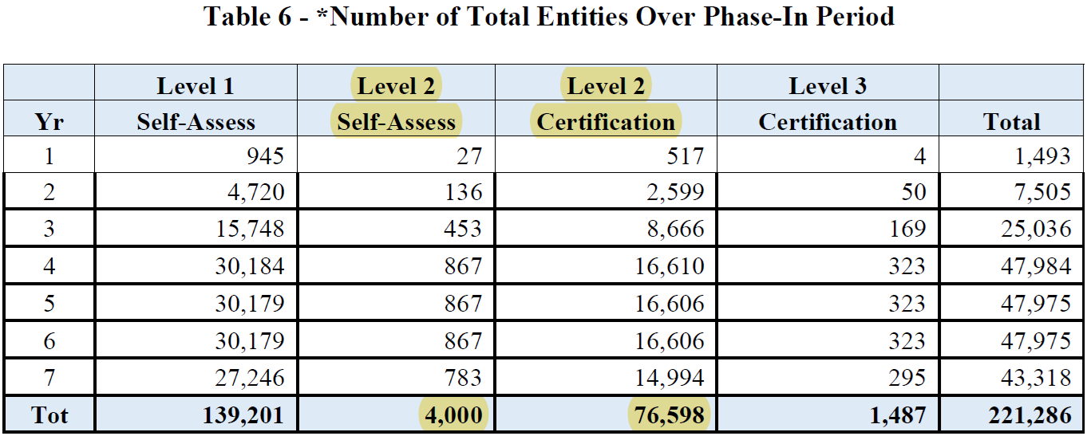
Impacted Population
DoD Estimates 95% of CMMC Level 2 Assessments will require Certified Third Party Assessment Organization (C3PAO) Certification Assessment.
Source: CMMC Proposed Rule dated 26 December 2023.

Slide 21
CMMC Documentation: NIST SP 800-171 SSPs & POA&Ms

Slide 22
NIST SP 800-171 Documentation
System Security Plan (SSP) documents compliance with NIST SP 800-171
Describes security controls in place plus system summary, system boundaries, and lists in-scope assets.
Contractor should consider 171A assessment objectives when completing SSP.
Assessment will be performed according to NIST SP 800-171A and (for Level 3) 800-172A
Must achieve all objectives under required control for control to be considered “MET”
Plan of Action & Milestones (POA&M) describes how unimplemented controls will be met in the future.

Slide 23
Plan of Action & Milestones (POA&Ms)
CMMC restricts POA&Ms depending on the Level.
No POA&Ms for Level 1.
POA&Ms allowed only for certain Level 2 and Level 3 security controls:
Point value is not greater than 1 (for Level 2),
Assessment score divided by the total number of security requirements is greater than or equal to 0.8, and
Control is not listed as ineligible POA&M control.
Contractors must close out POA&Ms (i.e. fully implement all pending controls) within 180 days of the initial assessment.
Failure to close out POA&Ms will result in contractual penalties and ineligibility for future contracts.

Slide 24
Assessments & Certification

Slide 25
Assessment Types
CMMC Level 1
Self-Assessment only
Re-assess every year following initial assessment
CMMC Level 2
Self-Assessment or Certified Third-Party Assessment Organization (C3PAO)-led Certification Assessment
Solicitation will specify Self-Assessment (5%) or C3PAO Assessment (95%)
Re-assess every three years following initial assessment
CMMC Level 3
Government-led Certification Assessment only
Must have Level 2 Final Certification before you can seek Level 3 assessment
Re-assess every three years following initial assessment

Slide 26
Assessment Procedure – Network Boundaries & Asset Definition
Scoping
Before assessing, must establish assessment scope
Determine where your data resides, and where it can flow to
Scoping is CMMC Level-specific
CMMC Asset Types
CUI/FCI Assets
Security Protection Assets
Contractor Risk-Managed Assets
Specialized Assets (e.g. Internet of Things, IIoT, Operational Technology, etc.)
Out-of-Scope Assets

Slide 27
Post Assessment Activities
Score submitted to SPRS
If all required controls fully implemented: Final Certification
Eligible for contract award requiring CMMC
If 1 or more POA&Ms: Conditional Certification
Eligible for contract award requiring CMMC, but must close out POA&Ms within 180 days and reassess to confirm
If POA&Ms are not closed out in time, Certification/status will expire
Self-Assessment ≠ Certification

Slide 28
Assessment Affirmations for all CMMC Levels
Contractors must submit senior official affirmations attesting compliance for each CMMC Level.
Requires prime contractor and applicable subcontractor to annually affirm they have implemented and will maintain compliance with applicable controls.
Contractors must also affirm compliance after every CMMC assessment for CMMC Levels 2 and 3.
Applies to both Self-Assessments, Certification Assessments, and after any POA&M close outs.
Must submit affirmation to be eligible for contract award.

Slide 29
Supply Chain Considerations

Slide 30
CMMC Effects on Supply Chain Management
CMMC aims to secure supply chain.
Security gaps would remain if only prime contractors were required to comply with security controls.
Flowdown requirements ensure subcontractors also comply with the same requirements as the prime contractor.
CMMC requirements will flow down to any subcontractor that processes, stores, or transmits FCI or CUI on contractor information systems.

Slide 31
Prime & Sub Interactions under CMMC
If a contractor knows their suppliers are not or cannot comply with the CMMC requirements but are still handling CUI, the prime contractor incurs serious risk.
What happens when a prime contractor must work with a supplier that cannot meet CMMC requirements?
Working with Critical Suppliers
Workarounds that keep CUI out of the suppliers’ networks
Do not share FCI/CUI with supplier
Supplier accesses information on prime’s network
Use government equipment/information systems

Slide 32
Supply Chain Risk Management
Know your data and who will handle it.
Understanding the data you handle and the data your subcontractors handle will be critical.
Establish a supply chain risk management (SCRM) plan.
Identify critical suppliers and determine their compliance posture and potential workarounds, if needed.

Slide 33
Health Care & Cybersecurity Enforcement Risks

Slide 34
Potential Theories of Liability for Cybersecurity Noncompliance
Fraudulent Inducement / Promissory Fraud
False Certification
Liability attaches to each claim submitted to the government under a contract, when the contract was originally obtained through false statements or fraudulent conduct.
Express certification
Implicit certification

Slide 35
Potential False Claims Act Liability under CMMC
Affirmations
“A senior official from the prime contractor and any applicable subcontractor will be required to affirm continuing compliance with the specified security requirements after every assessment, including POA&M closeout, and annually thereafter. Affirmations are entered electronically in SPRS.”
Potential predicates for investigation/liability:
CMMC status revocation
Inaccurate Self-Assessments
Failure to provide C3PAO or Government with accurate information for Certification Assessments
Failure to closeout POA&Ms in 180 days

Slide 36
DOJ Civil-Cyber-Fraud Initiative
In October 2021, DOJ announced the Civil Cyber-Fraud Initiative
Will utilize False Claims Act to pursue cybersecurity related noncompliance by government contractors and grant recipients.
Failure to meet specific contract terms
Misrepresentation of security controls and practices
Failure to timely report suspected breaches
Three cybersecurity failures that are prime for enforcement:

Slide 37
DoD OIG Support For Civil Cyber Fraud Initiative
From 2018 through 2023, the DoD OIG issued five audit reports focusing on DoD contractors’ inconsistent implementation NIST SP 800-171.
Since 2022, the DoD OIG has provided support for five investigations under the Civil Cyber Fraud Initiative, which targets government contractors and grant recipients suspected of fraudulently attesting their compliance with the NIST SP 800-171 cybersecurity requirements.
Report identified specific cybersecurity weaknesses that DoD OIG identified during CCFI Assessments, including password enforcement, user activity reports, and vulnerability identification and mitigation.

Slide 38
False Claims Act Cyber-Related Settlements
March 2022
July 2022
$9 million settlement to resolve allegations that federal contractor failed to comply with DFARS and NFARS contract clauses.
March 2023
September 2023
$930,000 to resolve allegations that contractor falsely represented compliance with contract requirements relating to the secure storage of medical records.
$300,000 settlement to resolve allegations that company failed to patch, update, and maintain a federally funded children’s health insurance website they created and hosted.
$4 million settlement to resolve allegations that certain telecommunications services government contractor provided to federal agencies under its GSA contracts did not comply with applicable cybersecurity requirements.

Slide 39
Key Takeaways

Slide 40
Key Takeaways
Know what regulated data you own and where it resides
Know your contract requirements and ensure you comply with them
Determine what compliance gaps exist and carefully track their remediation
Accurately report your cybersecurity compliance
Conduct cybersecurity risk assessments and audits under attorney-client privilege, where possible

Slide 41
Contact Information
Michael Gruden CMMC-RP, CIPP-G
Counsel, Crowell & Moring
mgruden@crowell.com
+1.202.624.2545
Payal Nanavati
Counsel, Crowell & Moring
pnanavati@crowell.com
+1.202.624.2580
Michael G. Gruden, a counsel at Crowell & Moring, is a former Pentagon information technology acquisition branch chief and a leading cybersecurity lawyer who helps government contractors navigate privacy, cybersecurity, and contract compliance requirements. Drawing from his experience at the U.S. Department of Defense and U.S. Department of Homeland Security, Michael represents some of the nation's largest defense contractors and tech companies as they prepare to meet the Cybersecurity Maturity Model Certification (CMMC) requirements and mitigate cyber threats. Michael is a Registered Practitioner under the CMMC framework and is also a Certified Information Privacy Professional with a U.S. government concentration (CIPP/G).
Payal Nanavati is a counsel and practices in the Health Care and Government Contracts groups. Payal’s practice covers a wide range of investigation, counseling, and litigation matters for companies in the government contracts and health care industries, two of the most highly regulated industries in the United States. Payal advises and advocates for government contractors and health care entities facing government investigations or high stakes litigation, with a particular focus on the False Claims Act, which is a heightened risk for members of both industries. Payal helps clients conduct internal investigations and strategically navigate regulatory inquiries, civil investigative demands, and subpoenas issued by federal and state agencies.

